Slide 1
Anaemia detection based on sclera and blood vessel colour estimation
- By Giovanni Dimauro, Mauro Giuseppe Camporeale, Alessandro Dipalma, Attilio Guarini, Rosalia Maglietta
A presentation by Shrey Gupta

Slide 2
Introduction
Anemia is a medical condition that occurs when there is a deficiency of red blood cells or hemoglobin in the blood, leading to a reduced ability of the blood to transport oxygen to the body's tissues.
Anemia can be caused by various factors such as iron deficiency, chronic diseases, genetic disorders, and pregnancy, and it is a common condition that affects many people worldwide.
The diagnosis of anemia typically involves a blood test to measure the level of hemoglobin and other blood components, but this can be costly and time-consuming, particularly in resource-limited settings.

Slide 3
Background & Objective
Computer vision techniques have been used in recent years to develop non-invasive methods for diagnosing anemia based on the analysis of images of the eye, particularly the sclera and blood vessels.
The use of computer vision techniques for anemia detection has several advantages, including cost-effectiveness, non-invasiveness, and the potential for remote monitoring and screening.
The aim of the paper is to present a method for anemia detection based on sclera and blood vessel color estimation using image processing and machine learning algorithms, and to evaluate its effectiveness using a dataset of images of the eyes of patients with varying levels of anemia.

Slide 4
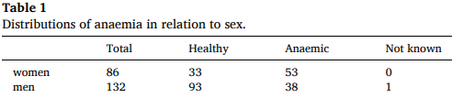
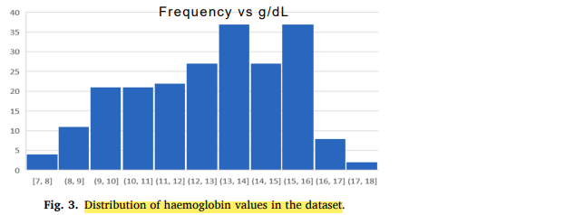
Dataset
Eyes-defy-anaemia has been used
It includes
photos of the original eyes
only segmented palpebral
bulbar conjunctiva.
The Eyes-defy-anaemia dataset consists of photos of 218 patients
The ages of all subjects were 19–88 years with an average of 42 years.
The haemoglobin values were 7–17.4 g/dL with an average of 12.7 g/dL

Slide 5
Proposed algorithm for sclera segmentation
Picture enhancement
Thresholding
K-means clustering and normalized cuts
Improving precision

Slide 6
Vessel detection
Weighted line detection
Vessel centerlines
Post-processing

Slide 7
Extracted features
RGB, HSL and CieLAB colour spaces were used in this study
For both the entire sclera and extracted vessels, the average of the following channels were taken
R channel value; G channel value; B channel value;
L* channel value; a* channel value; b* channel value;
H channel value; channel S value; L channel value;
R-G channel value (defined as EI, erythema index)

Slide 8
Classification
Several classification algorithms were applied to detect anaemia through sclera and vessel colour features
SVM with C parameter in range (1, 100) with a step of 20; kernel between “linear”, “rbf” and “poly”; gamma between “scale” and “auto”; degree of 2–5;
KNN with neighbours in the range of 1–10 and weights between “uniform” and “distance”;
Random forest with the criterion between “Gini” and “entropy”; max_features between “auto”, “sqrt”, and “log2”; n_estimators in the range of (1, 100) with a step of 20;
AdaBoost with n_estimators in the range of (1, 100) with a step of 2

Slide 9
Results
Results on sclera segmentation
Results of vessel segmentation
Classification results

Slide 10
Conclusion
The proposed algorithm for sclera segmentation has comparable performance to state-of-the-art algorithms; its F1 score is 87 %
The good classification results obtained using the average EI value and average a* value as features imply a good correlation between the colour (paleness/ redness) of segmented regions (sclera and vessels) and the haemoglobin value
The best-performing SVM is a support vector machine with a polynomial kernel
The proposed method has the following advantages
it is easy and quick to use, is noninvasive and does not discomfort the patient;
the device to take eye photos does not require the intervention of specialized personnel;
it is not influenced by other pathologies because it is based on the properties relating to the colour of the vessels

Slide 11

Thank You

